Slide 1
Software Engineering Unit-II
Prepared by: Neha Tripathi

Slide 2
Requirement Elicitation and Analysis

Slide 3
Requirement Engineering Process
It is a four-step process, which includes -
- Feasibility Study
- Requirement Elicitation and Analysis
- Software Requirement Specification
- Software Requirement Validation
- Software Requirement Management

Slide 4
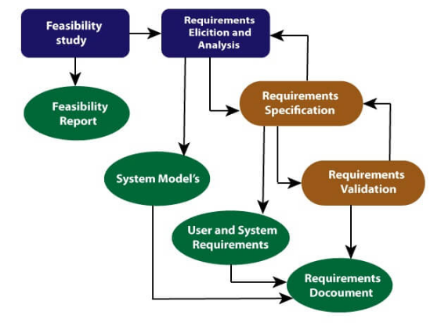
Requirement Engineering Process

Slide 5
2.Requirements Elicitation and Analysis:
After an initial feasibility study, the next stage of the requirements engineering process is requirements elicitation and analysis.
This is also known as the gathering of requirements. Here, requirements are identified with the help of customers and existing systems processes, if available.
In this activity, software engineers work with customers and system end-users to find out about the application domain, what services the system should provide, the required performance of the system, hardware constraints, and so on.
Analysis of requirements starts with requirement elicitation. The requirements are analyzed to identify inconsistencies, ambiguities, redundancies, defects, omission, etc. We describe requirements in terms of relationships and also resolve conflicts if any.

Slide 6
Requirements Elicitation and Analysis-Stages
Software engineers work with a range of system stakeholders to find out about the application domain, the services that the system should provide, the required system performance, hardware constraints, other systems, etc.
Stages include:
Requirements discovery,
Requirements classification and organization,
Requirements prioritization and negotiation,
Requirements specification.

Slide 7
The requirements elicitation and analysis process

Slide 8
Process activities
Requirements discovery
Interacting with stakeholders to discover their requirements. Domain requirements are also discovered at this stage.
Requirements classification and organisation
Groups related requirements and organises them into coherent clusters.
Prioritisation and negotiation
Prioritising requirements and resolving requirements conflicts.
Requirements specification
Requirements are documented and input into the next round of the spiral.

Slide 9
Requirements discovery
The process of gathering information about the required and existing systems and distilling the user and system requirements from this information.
Interaction is with system stakeholders from managers to external regulators.
Systems normally have a range of stakeholders.

Slide 10
Stakeholders in the MHC-PMS
Patients whose information is recorded in the system.
Doctors who are responsible for assessing and treating patients.
Nurses who coordinate the consultations with doctors and administer some treatments.
Medical receptionists who manage patients’ appointments.
IT staff who are responsible for installing and maintaining the system.
A medical ethics manager who must ensure that the system meets current ethical guidelines for patient care.
Health care managers who obtain management information from the system.
Medical records staff who are responsible for ensuring that system information can be maintained and preserved, and that record keeping procedures have been properly implemented.

Slide 11
Requirement Elicitation techniques
Requirements Elicitation is the process to find out the requirements for an intended software system by communicating with client, end users, system users and others who have a stake in the software system development.
There are various ways to discover requirements
- Interviews
- Questionnaires
- Onsite observation
- Survey
- Existing manuals and documentation
- www
- Group discussion
- Scenarios
- Use cases
- Prototyping
- Ethnography
- Brainstorming etc.

Slide 12
Problems of requirements elicitation
Stakeholders don’t know what they really want.
Stakeholders express requirements in their own terms.
Different stakeholders may have conflicting requirements.
Organisational and political factors may influence the system requirements.
The requirements change during the analysis process. New stakeholders may emerge and the business environment change.

Slide 13
Thank You!

